Slide 1
Idea Harvest 2.0 – Mendel
Account Name: AbbVie Inc.
Team Captain : Raju Chowdhury (434896)

Slide 2


Medical Sales Representative

Slide 3




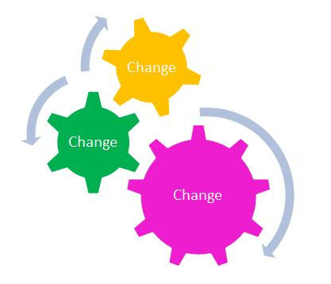

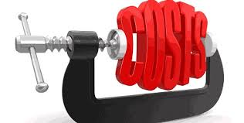
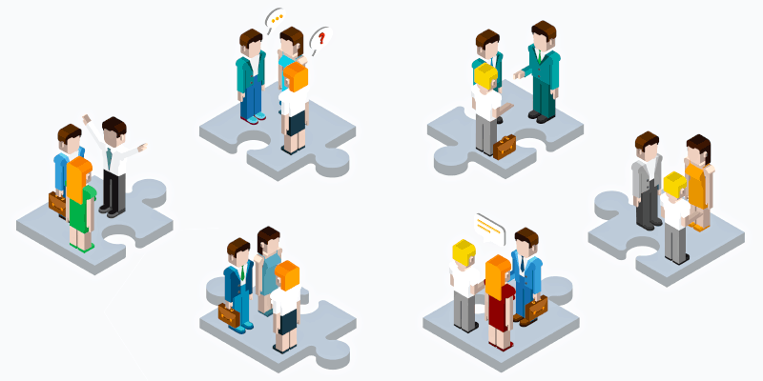
Current Industry Facts
Top 10 Pharma
S&M
Spend
55%
spend on F2F promotional activities
R&D
Spend
68% of global marketing spend in pursuance of HCP/Accounts
Impending Challenges
Restricted Access
Price / Low Margin
Regulatory Constraints
Shifting Market Dynamics
Departmental Silos
Notes:
https://arstechnica.com/science/2019/01/healthcare-industry-spends-30b-on-marketing-most-of-it-goes-to-doctors/
https://www.drugwatch.com/featured/big-pharma-marketing/
https://www.washingtonpost.com/news/wonk/wp/2015/02/11/big-pharmaceutical-companies-are-spending-far-more-on-marketing-than-research/?noredirect=on&utm_term=.30951e8057e2
https://spartanideas.msu.edu/2015/03/01/design-critique-putting-big-pharma-spending-in-perspective/

Slide 4
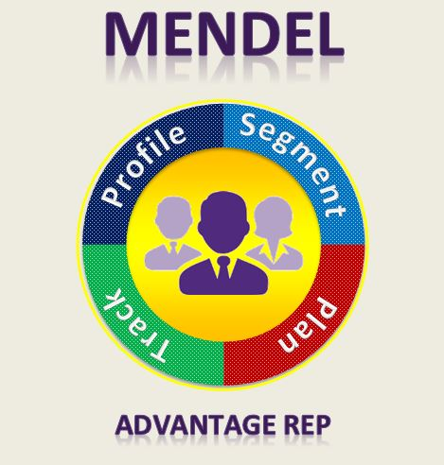

Slide 5

Amalgamation of
Traditional vs AI/ML approach

Slide 6


Customer 360
NLP with Deep Learning
Unstructured Data
Sentimental analysis using summarization of Patient and other reps feedback and Experience
HCP KPI Summarization
Web Scrapping
Descriptive Analytics
Propensity Score
Decile
Demographic details
Affiliations
Payment data
Engagement Channel
Recommended Messages
Behavioral Info
Structured Data
Customer 360 Data Store
Cafe Pharma
Viva Open data
NPI Federal site
Health News
CMS Payment
OPEN SOURCE
Calls, Emails, Digital Touchpoints, SFE data from tool
Client System
QUANT Modelling
Clustering, Propensity Score with ML Algorithm's

Slide 7









Recommendation Engine
Cluster Analysis (Elbow K Means)
Segment
Classification
Model (XGB Model)
Propensity Score
Affiliation
Alignment
Call Activity
Call Plan
Physician
Prescription
Profiling
Recommended target list of HCP/ Accounts
Suggestions for next best plan/actions/offer
Suggestion Engine
Hybrid approach for recommendation
combining machine learning algorithm,
which provides a trained base model complementing
with a rule-based expert system
Call
Mail
Rep Call
ISA Call
Sample
Past Touchpoint
Next Touchpoint/Offer
High Potential
Low Royalty
Customer Journey
High Potential
High Royalty

Slide 8
